Slide 1
Collidium
Seattle Collision research tool

Slide 2
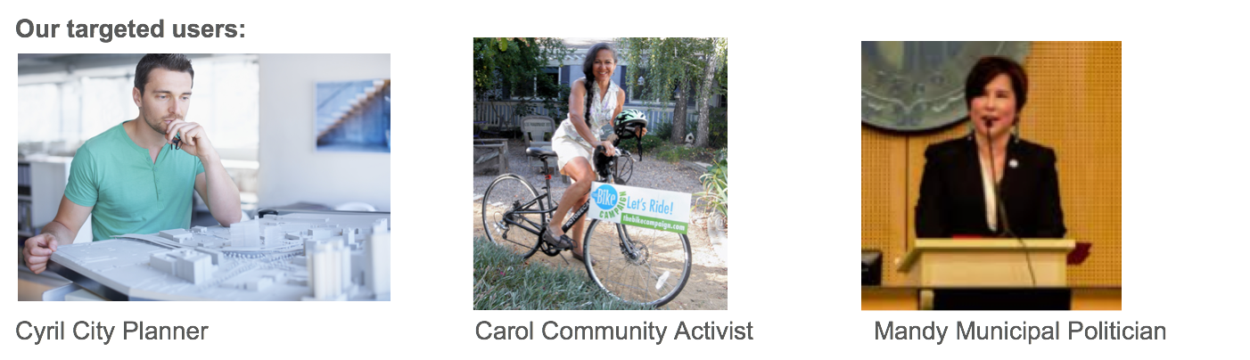
We are developing five use cases for our targeted users
Collidium: Seattle collision research tool
Each of these users wants information to help them support their agenda. Their priorities are:
Information is presented in a way that is easy to interpret
They can select options to focus on the questions that are most interesting to them

Slide 3
Use Cases
Collidium: Seattle collision research tool
Each of our use cases allows users to see visualizations of data that is filtered in different ways. These include:
Time frame of construction: “I want to see how collisions increased around buildings built in 2016”
Building type: “I want to see how multifamily construction affects collisions. Now I just want to look at commercial construction”
Accident victims: “I only want to see accidents that involve pedestrians or cyclists”
Accident severity: “I only care about accidents with injuries”
Distance between collision and construction: “I am interested in accidents that were directly adjacent to new construction” or “I want to see how accidents change up to a quarter mile from the new building.

Slide 4
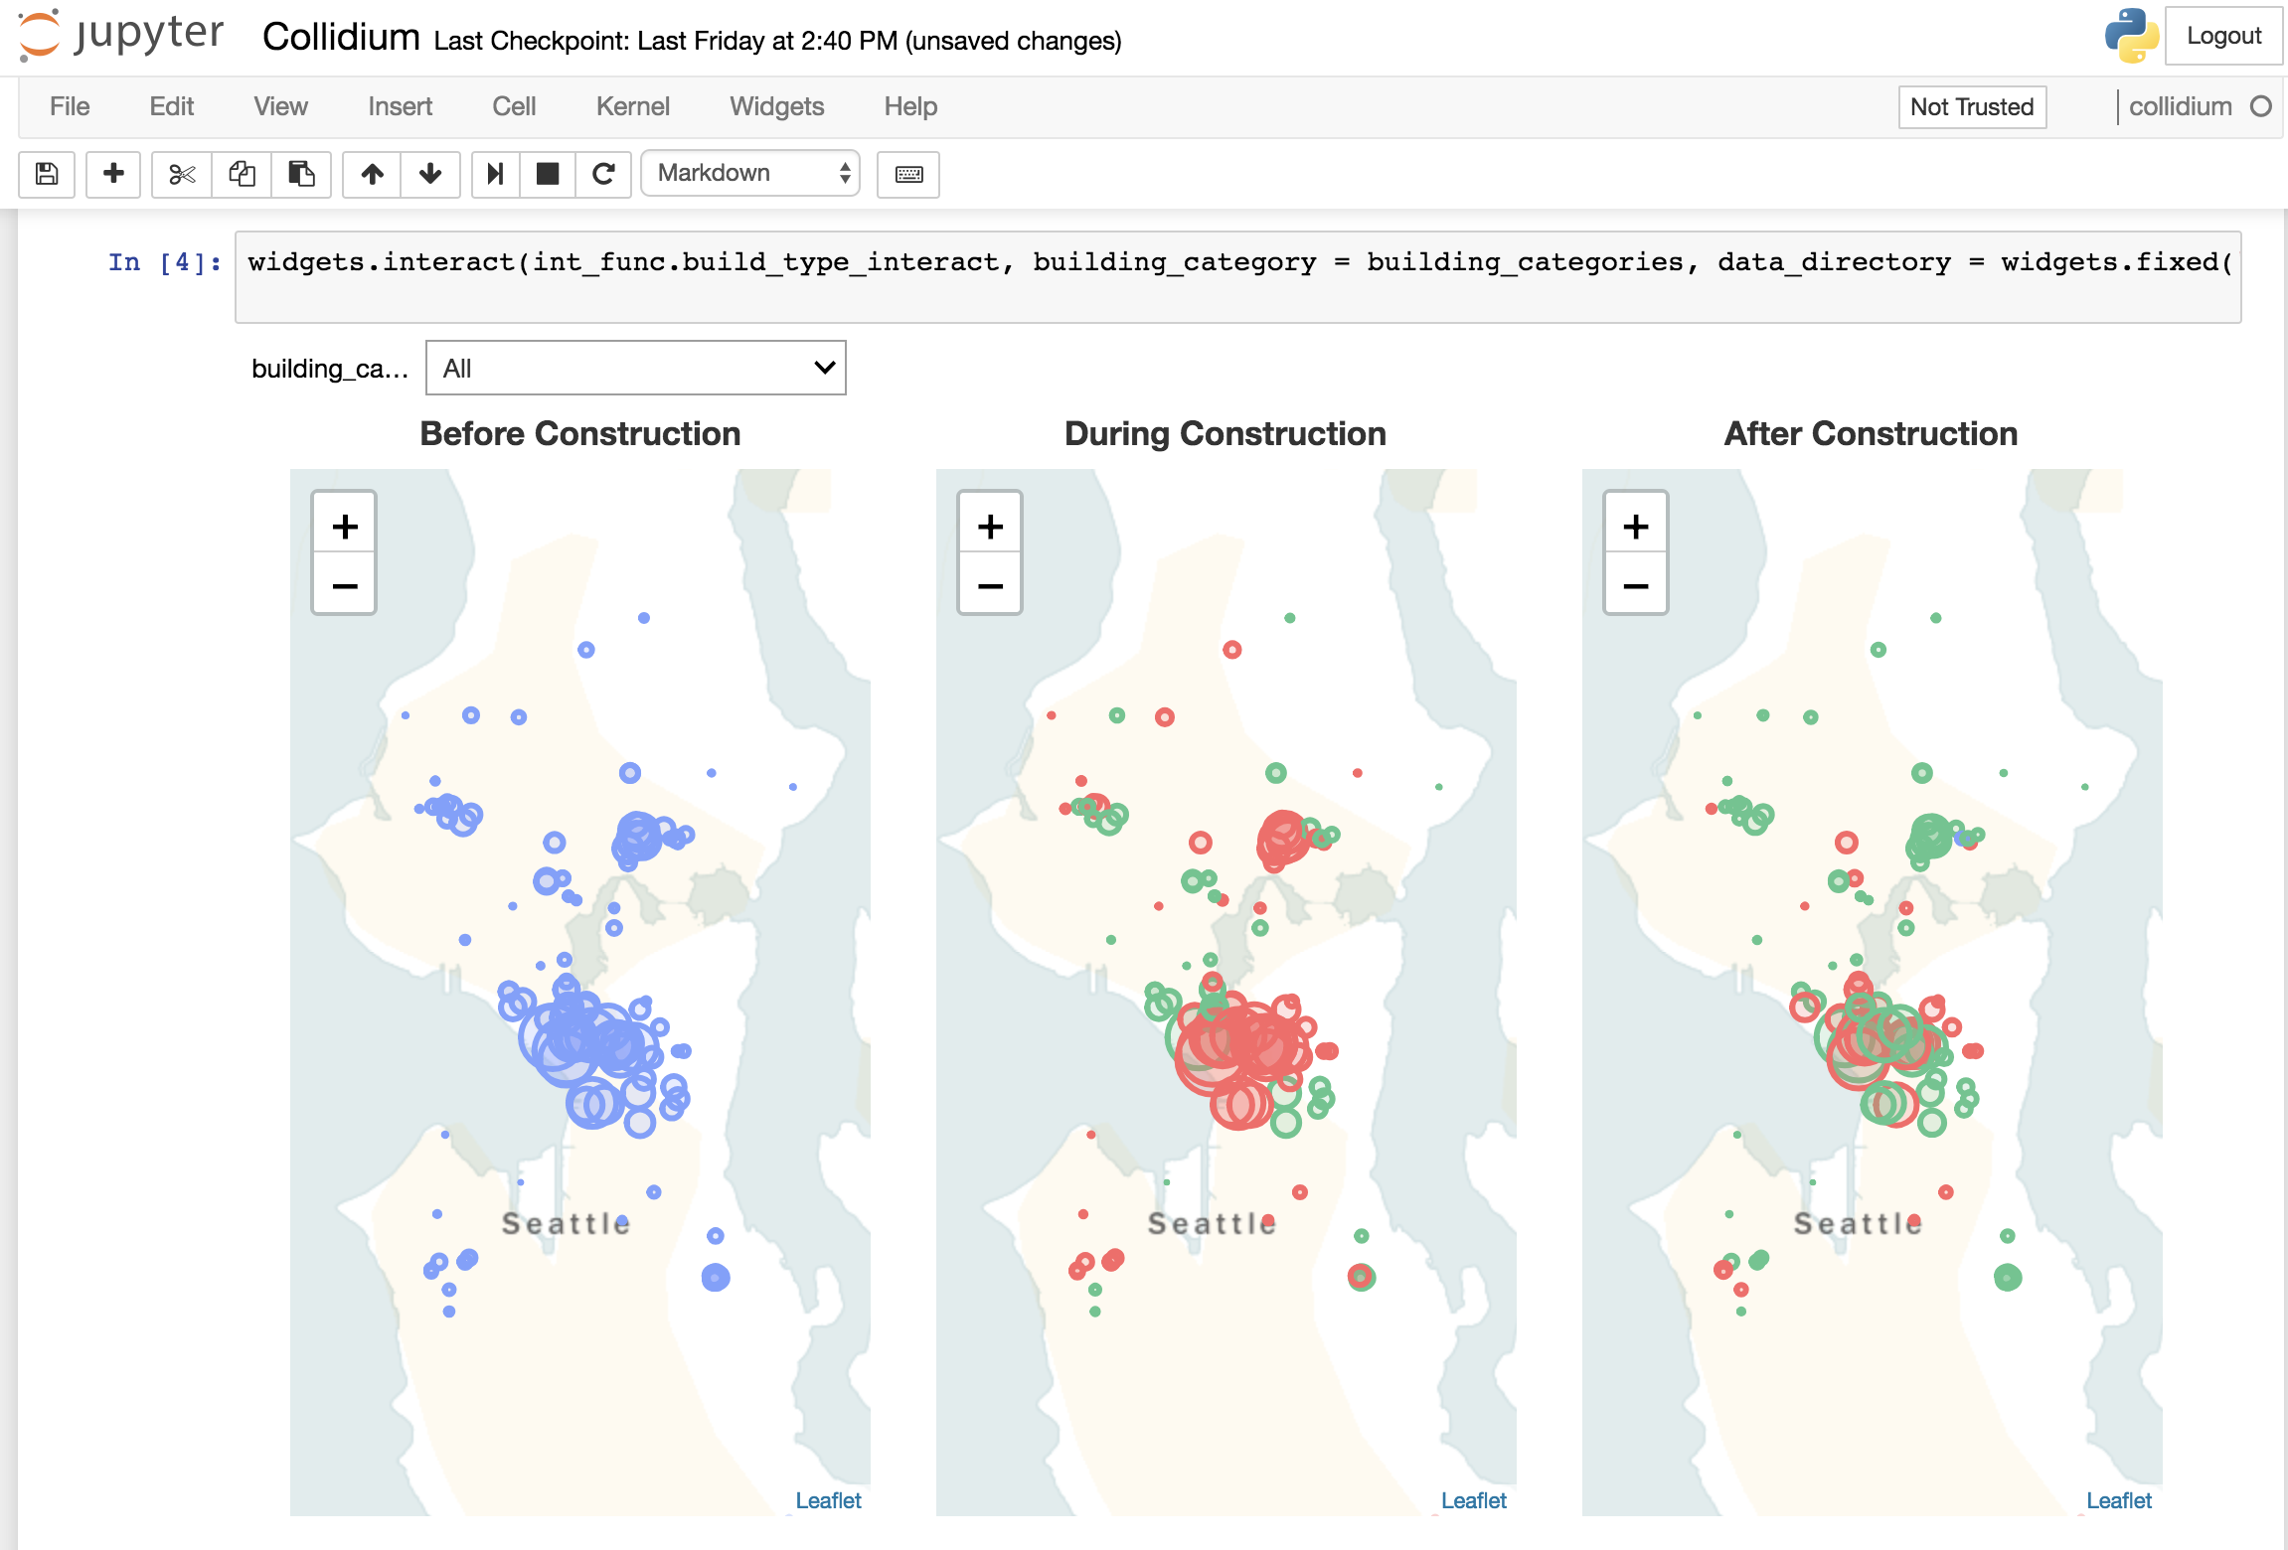
Demo
Collidium: Seattle collision research tool

Slide 5
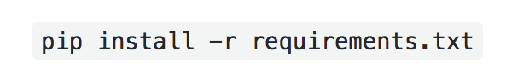
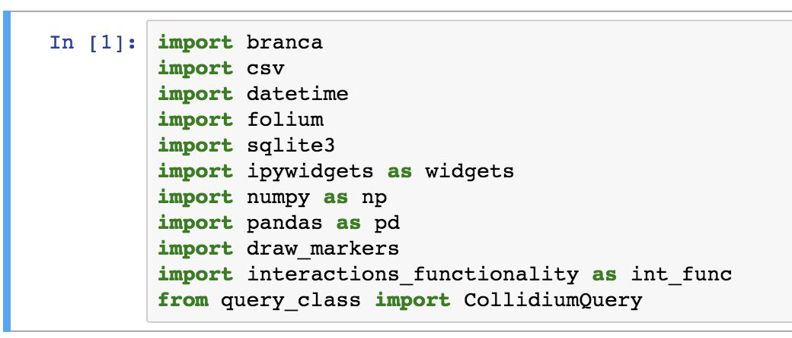
Environment
Collidium: Seattle collision research tool
Compatible with Python 3.5 or later
Users can pip install package requirements or use minimal environment
Package Dependencies
pandas
numpy
branca
folium
ipywidgets
geopy
ipython

Slide 6
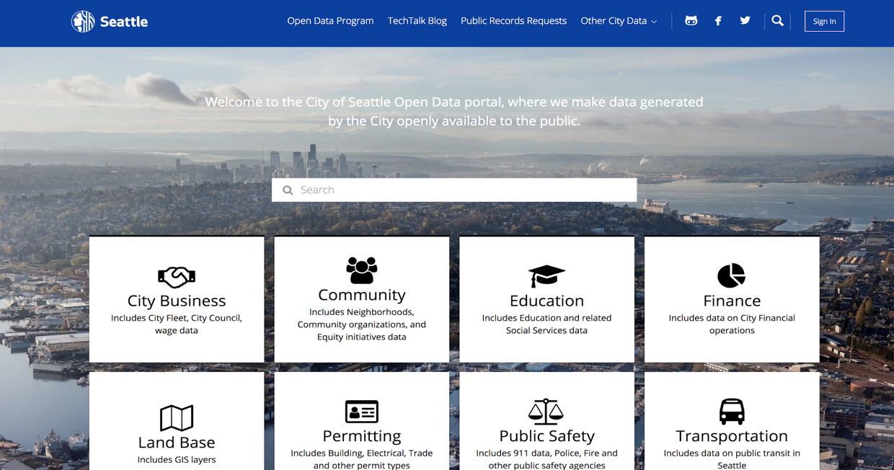
Seattle open data portal
Collidium: Seattle collision research tool

Slide 7
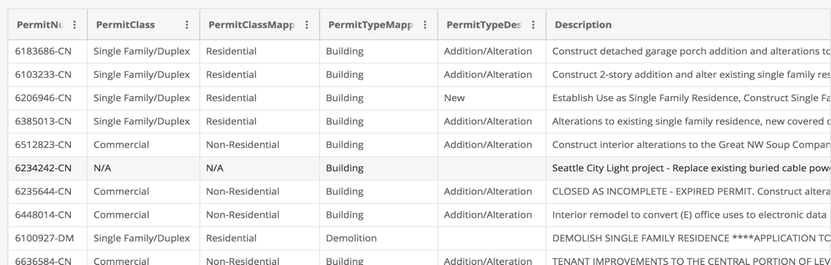
Building Permit Dataset
Collidium: Seattle collision research tool
Contains information on 60,000 building permits (2014-2018)
Collidium only uses permit values greater than $1 million (440 buildings)

Slide 8
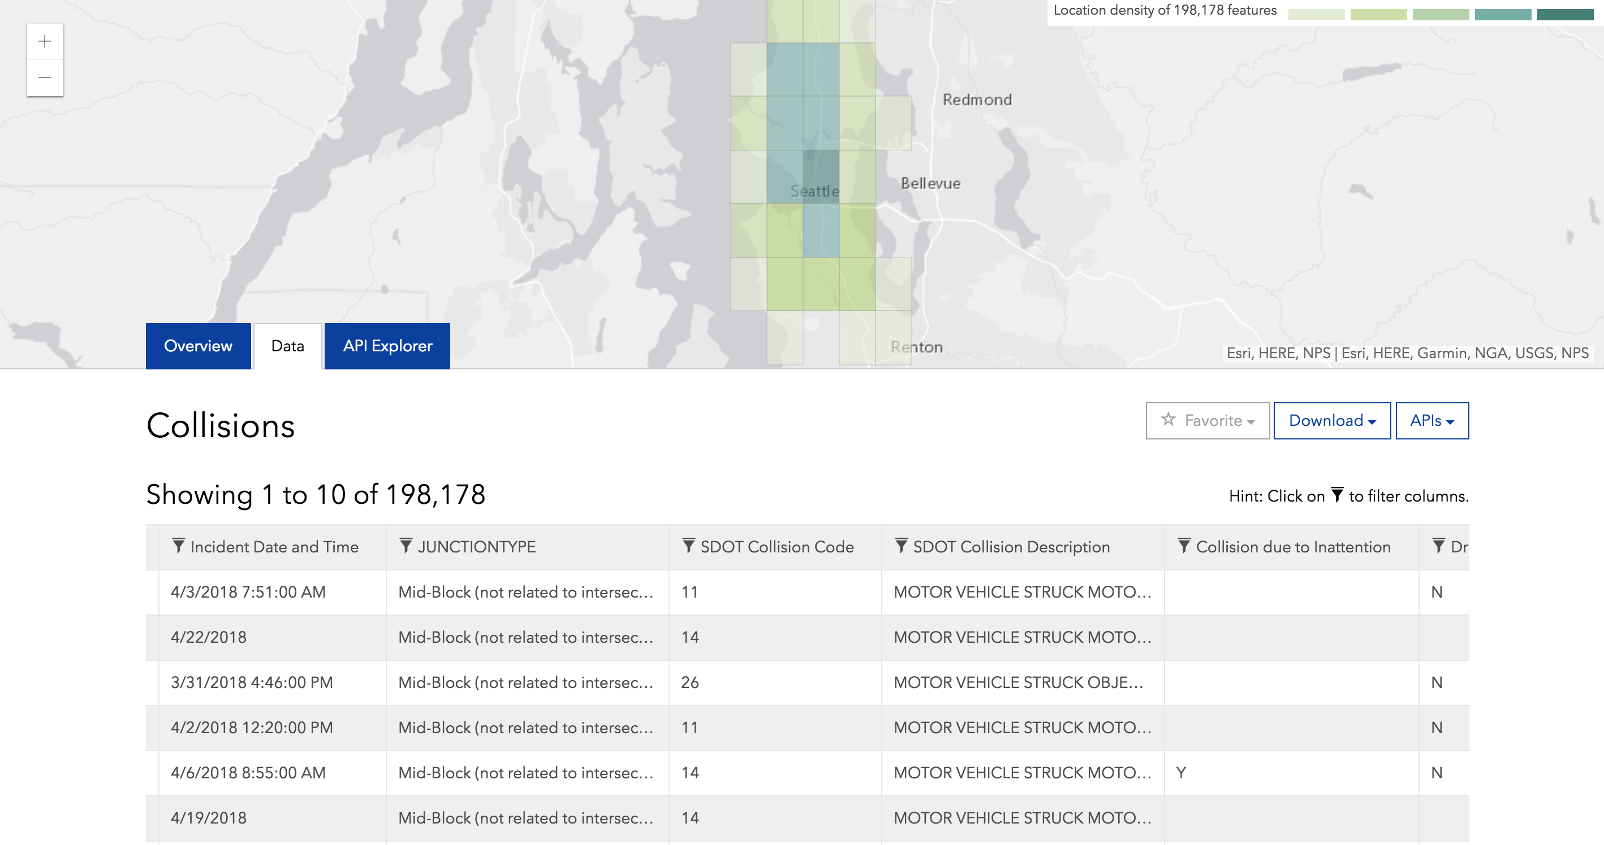
Collisions Dataset
Collidium: Seattle collision research tool
Contains information on nearly 200,000 collisions from 2003-2018
Filtered for collisions occurring 2013 or later, occurring within 1,500 feet and one year of an active building permit

Slide 9
Collidium Database
Collidium: Seattle collision research tool
Collidium Database Construction
Estimate distances between collisions and building permits
Link together collisions and building permits based on criteria
Convert into database, access with SQLite queries when interacting with Folium maps.

Slide 10
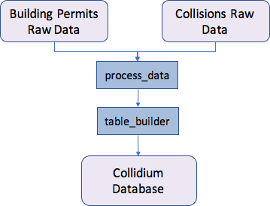
Project Components
Collidium: Seattle collision research tool

Slide 11
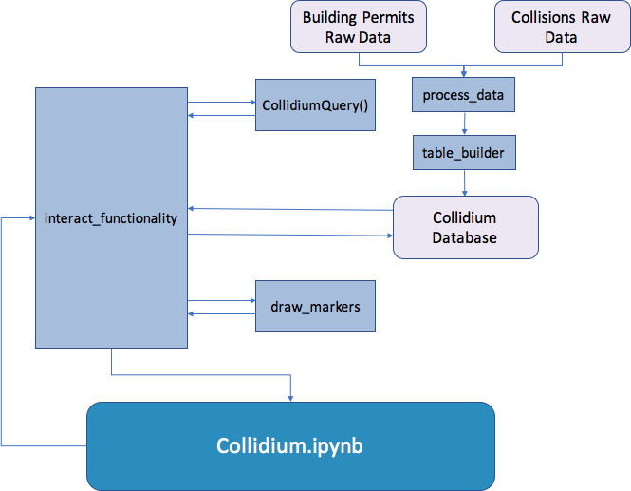
PRoject Components
Collidium: Seattle collision research tool

Slide 12
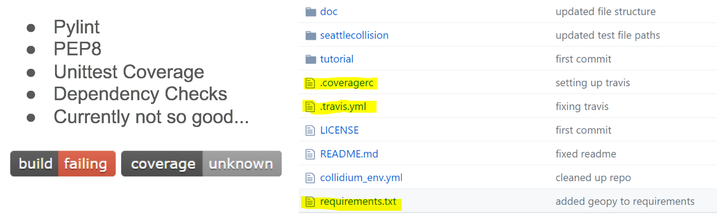

project structure: travis
Collidium: Seattle collision research tool

Slide 13
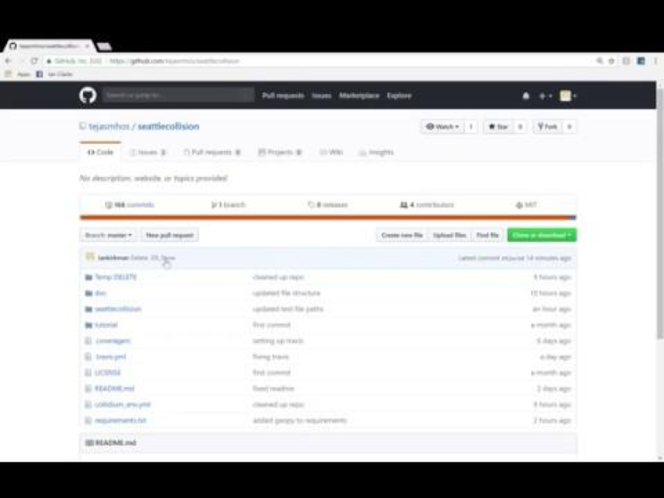
project structure: shablona compliant
Collidium: Seattle collision research tool

Slide 14
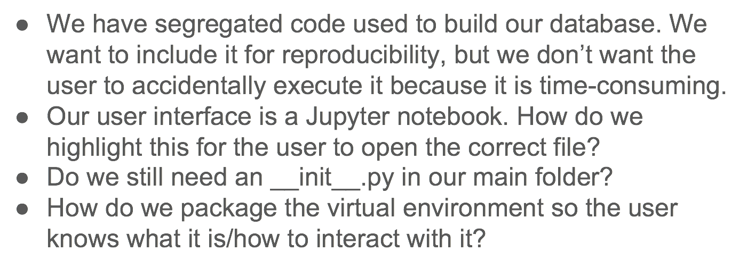
project structure: How to package?
Collidium: Seattle collision research tool

Slide 15
Lessons learned
Collidium: Seattle collision research tool
Coordination and Collaboration in Git
Folium is an excellent mapping package, but making visualizations can be overly complex and cumbersome
Tradeoffs between pre-processing and on the fly data processing.

Slide 16
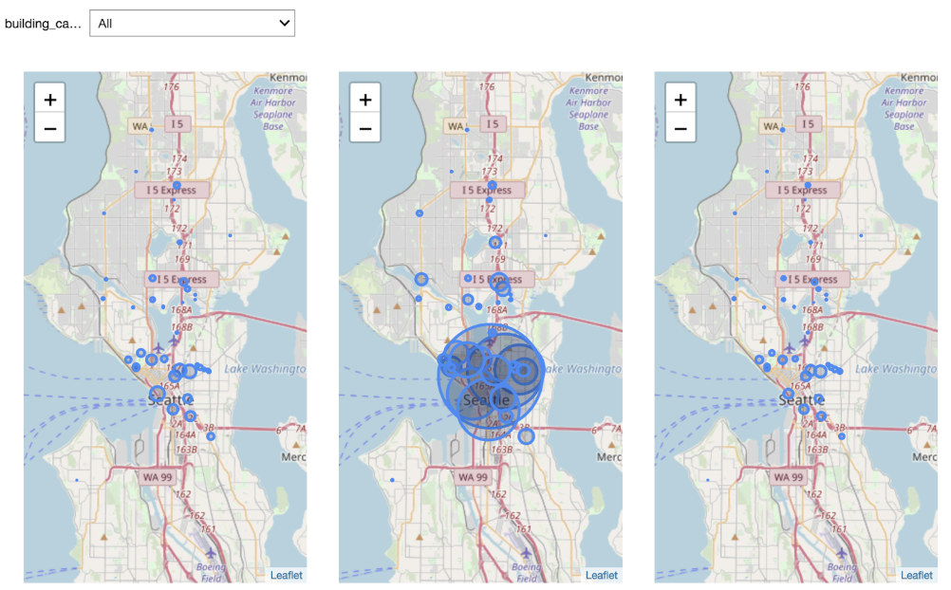
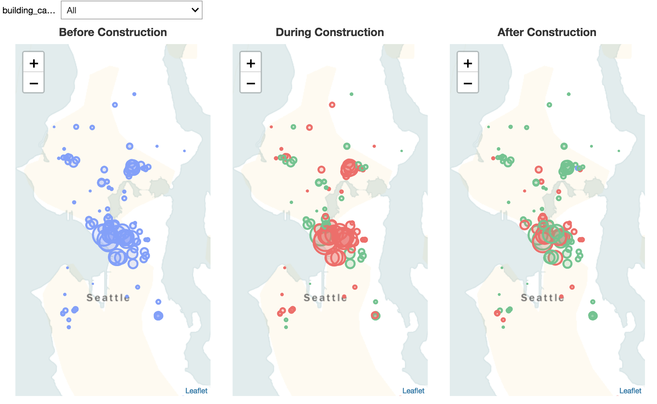
Updates since Last Week
Collidium: Seattle collision research tool
More minimalist Folium map detail
Color coding to better display increases and decreases in collisions
Added map labeling, legend

Slide 17
Future Work
Collidium: Seattle collision research tool
More interaction, details on demand for specific buildings
More investigative statistics regarding research question, including changes over time, statistical significance of increase/decrease in collisions, etc.
Explore other types of visualizations to convey changes in collision types
Structure our project as a website to improve accessibility.

Slide 18
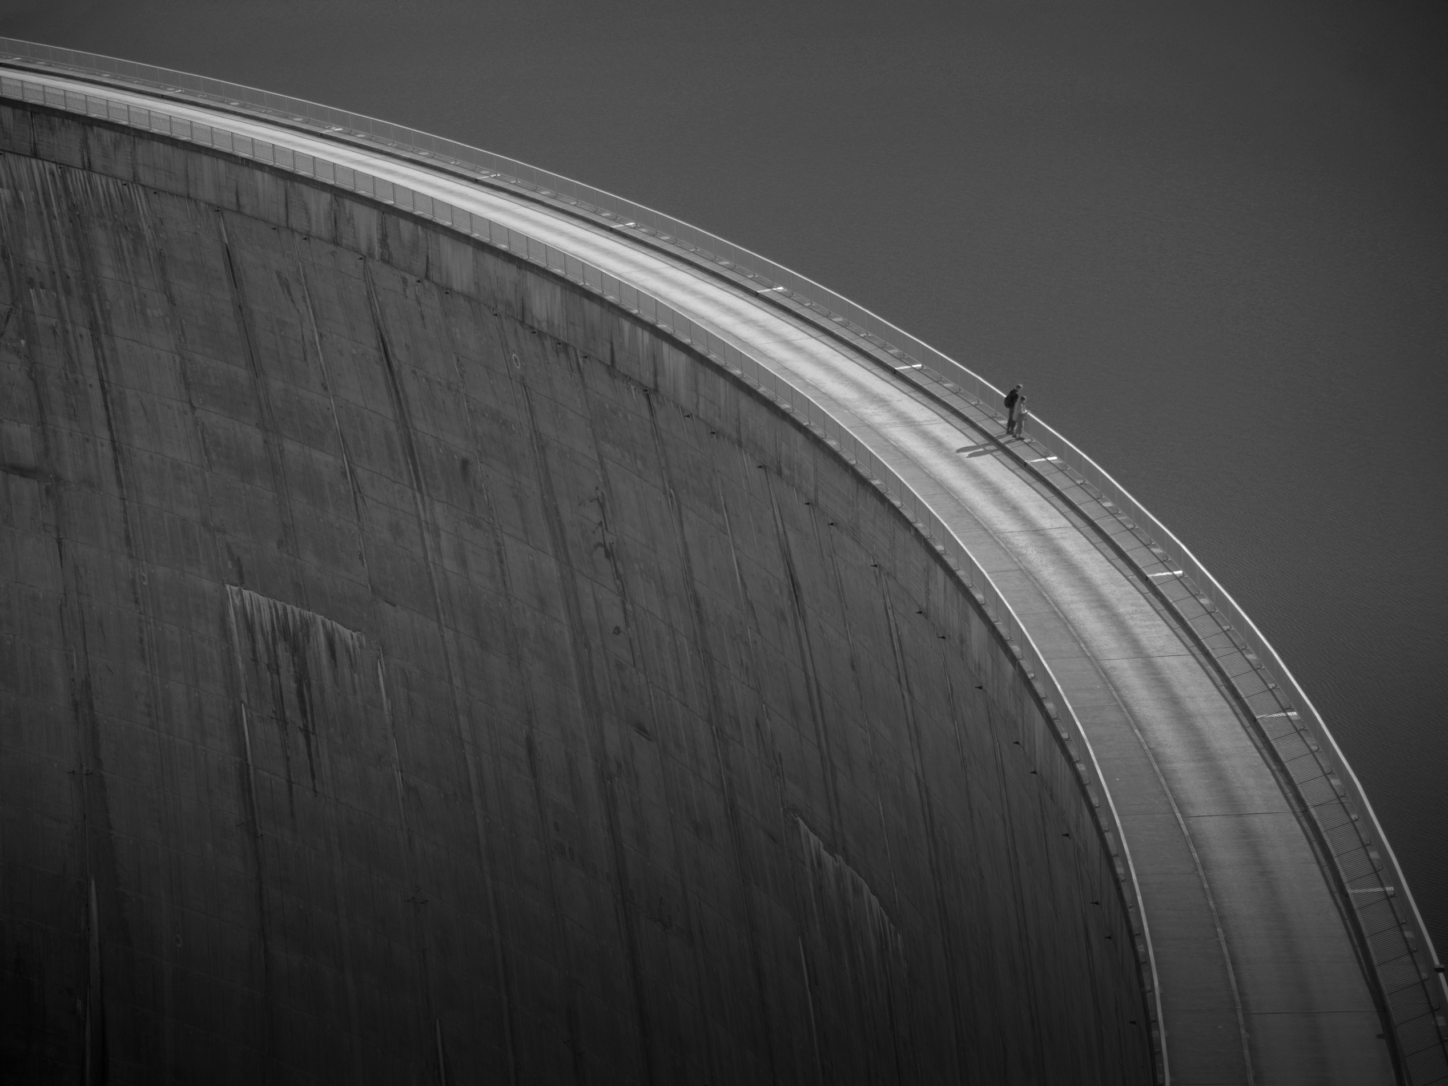
Thank you!

